Slide 1
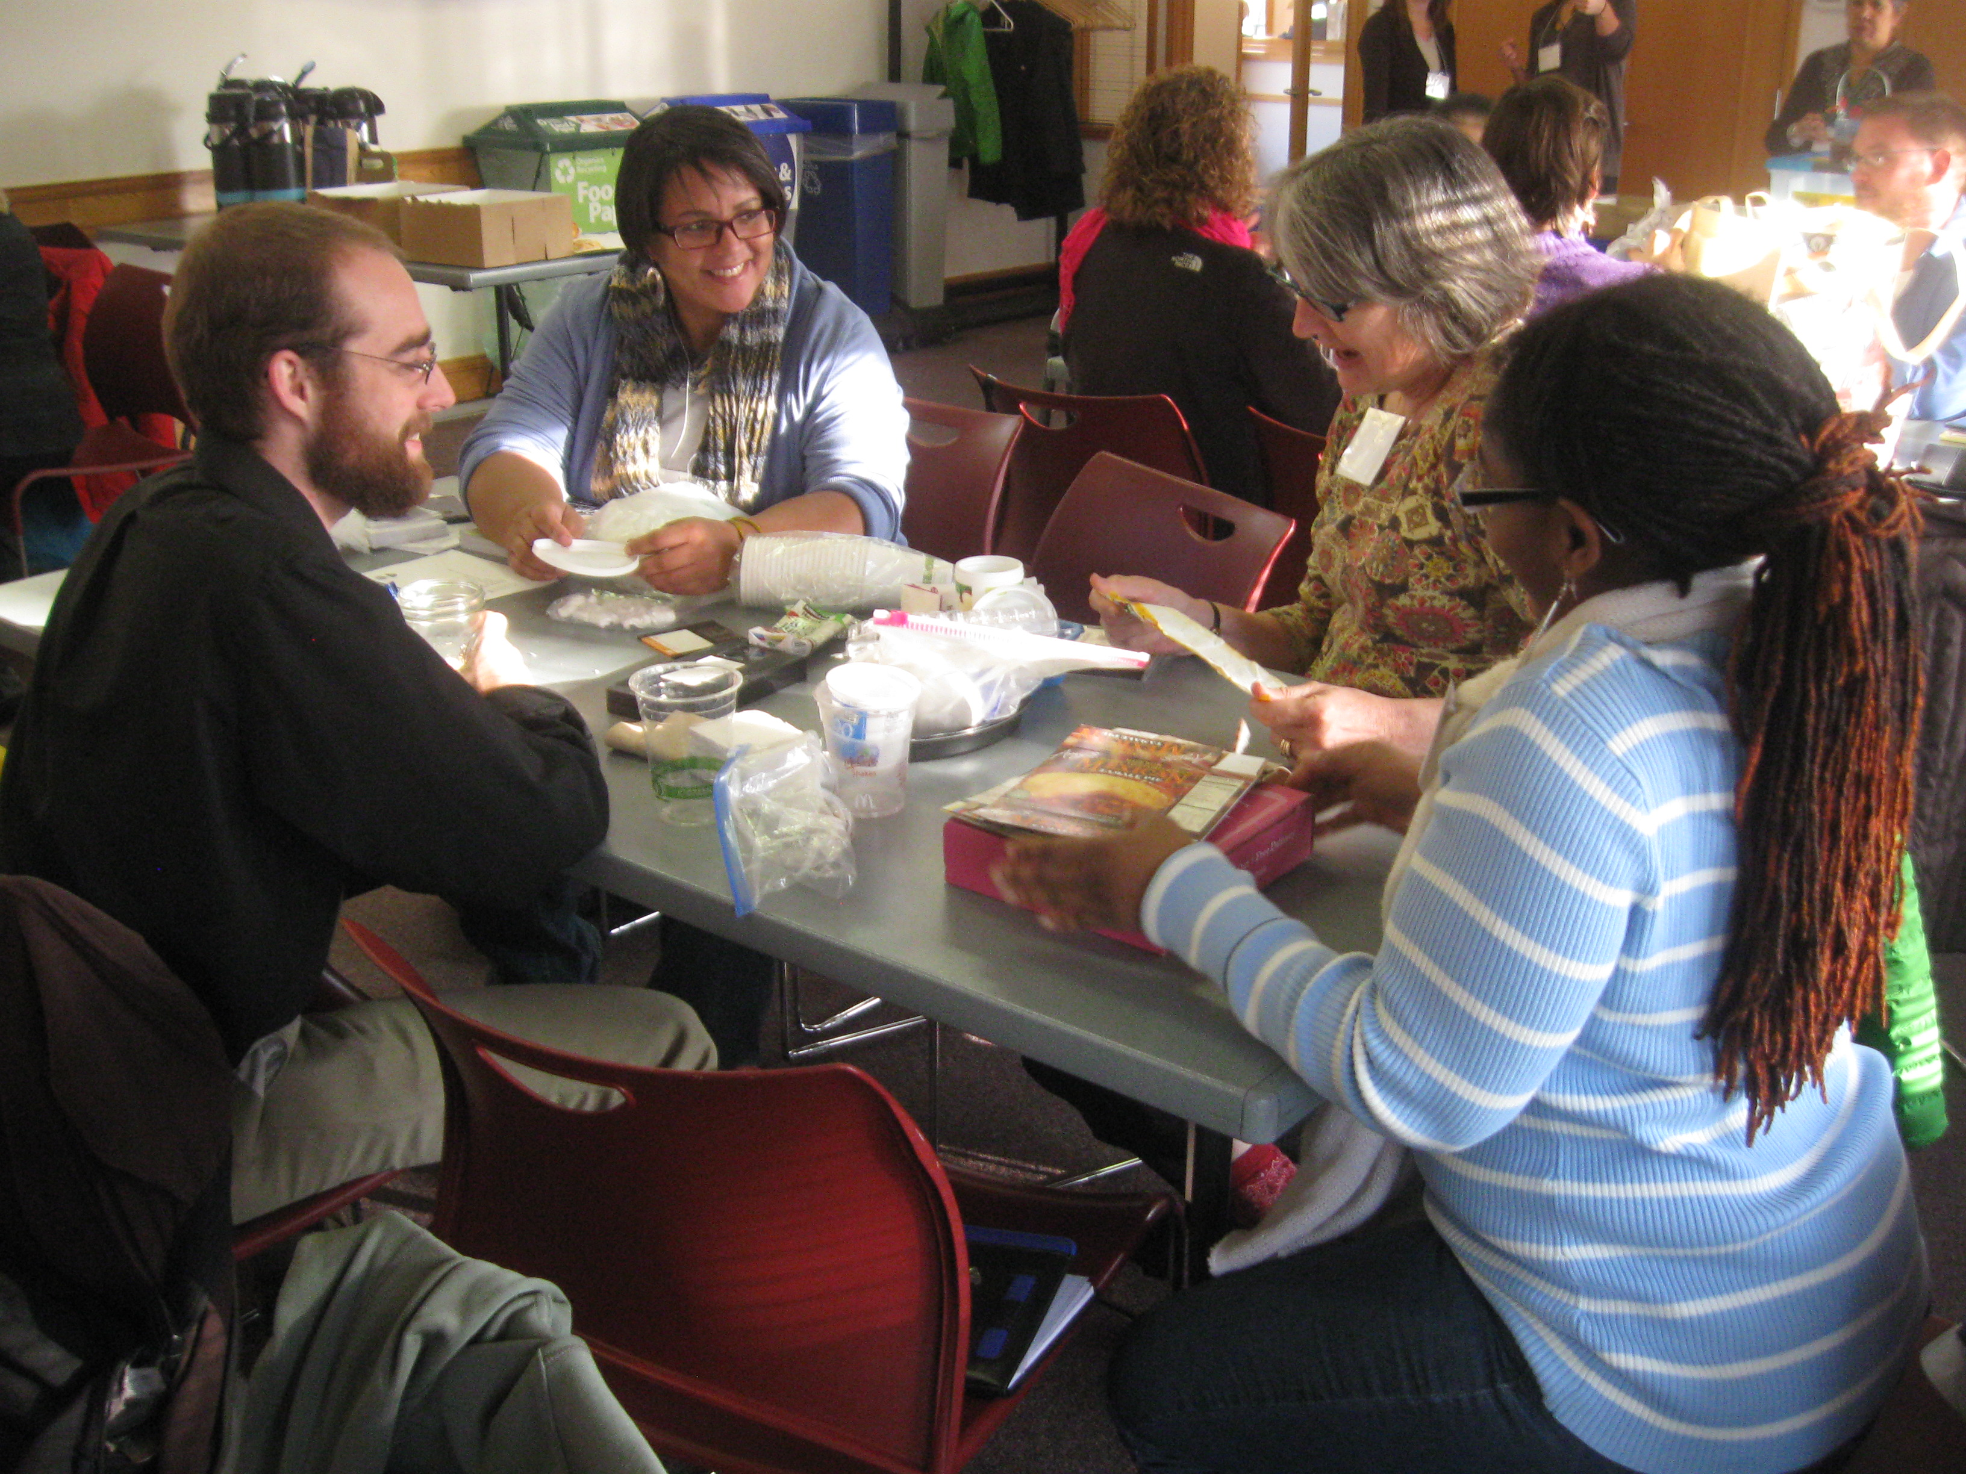
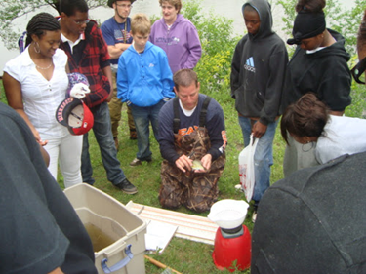
Motivating Action!
Patience Caso, Green Partners Program Manager
Notes:
Biking to work
I had the equipment (bike, panniers, etc.)
I had the knowledge (had ridden bike route on weekends)
Knew it was a bad choice regarding sustainability
Still drove – easy, routine, free
Barriers
Not leaving enough time
Not planning ahead

Slide 2
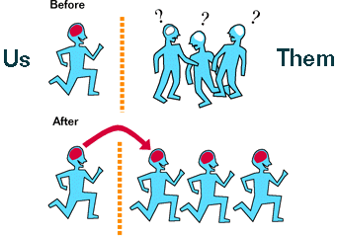
Motivating Sustainable Behaviors
Information-intensive campaigns are ineffective
Assumptions:
  Information = behavior
Notes:
Social media popular because relationship/engagement focused is more effective than ads.
We often assume that if we simply give people knowledge about a topic, they will be motivated to act
(Exercise example, bicycling to work example)
We assume that changes in attitudes and increased knowledge will lead to change.

Slide 3
Why prevalent?
Underestimate difficulty of changing behavior
Information campaigns are easy
Lack of evaluation
Notes:
Changing behavior is difficult – advertising is effective in getting people to choose one brand over another (they’ve already adopted the behavior of consuming), but getting them to behave in a different way, develop a different habit is difficult
Pushing out information, developing written materials, advertising is relatively easy
We don’t adequately evaluate our programs, so think they’re effective or don’t know.
Often evaluate outputs (number of people reach, participants, flyers distributed) rather than outcomes (behavior change, change in resource use, change in resource quality)

Slide 4
Community-based social marketing
Select behaviors
Identify barriers and benefits
Develop strategy
Pilot and evaluate
www.cbsm.com
Dr. Doug Mckenzie-Mohr
Notes:
Stresses importance of the social aspect of the behaviors we adopt
Identifies and addresses barriers to engaging in a behavior. Barriers are community and behavior specific
Turning awareness into action
Research to identify the true barriers and benefits (real and perceived) of the behavior change
Develop strategies using proven effective tools

Slide 5
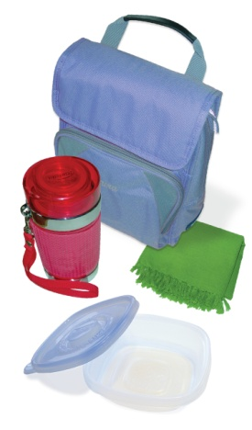
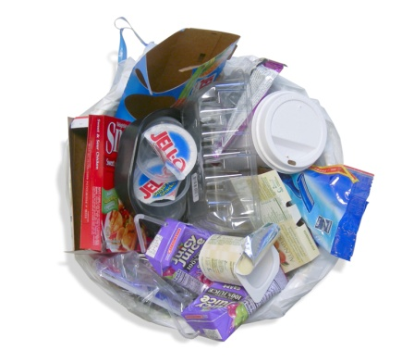

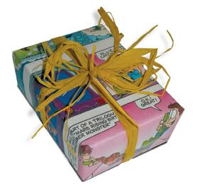


Step 1: Select behaviors
Specific
Specific
Impactful
  Environmental impact
  Likelihood to adopt behavior
  Influence on others
Direct
Notes:
Need to be able to identify specific steps needed to engage in the behavior.
If too vague, will struggle to identify barriers and communicate to your audience what they should do
Water: redirect downspouts, rain barrel, measure vol. of roof for 1 inch rain
DESIRED RESULT:
ENVIRONMENTAL IMPACT: Not purchasing low flow showerheads, but installing them
PROBABILITY: Rain garden workshop with apartment dwellers? Downspouts are relatively easy to move
INFLUENCE: How many people are already engaged in this? What is the opportunity for new adopters?

Slide 6

Step 2: Identify barriers and benefits
What stands in the way?
What is the benefit?
Don’t assume, ask!
  Surveys, focus groups, observation, research
  Worksheet Q1 & Q2
Notes:
Barriers: What does your target audience find challenging about engaging in this behavior?
Benefits: What do they perceive to be the benefit of engaging in this behavior?
Don’t assume: It is human nature to make speculations about why people act in a certain way, but only by doing the appropriate research can we truly know what the barriers and benefits are
Research methods
Focus groups
Surveys
Observation
Literature review

Slide 7
Step 3: Develop strategy
Know Your Audience
Consider age, culture, values, interests
Provide experiential, hands-on learning
Incorporate leadership and service learning
Integrate personal or community goals
Provide feedback on impact of behavior change
Notes:
Communication can be an effective strategy – but you want to make sure you’re addressing an information-gap barrier

Slide 8
Step 3: Develop strategy
Communicate
One-way
  Website
  Email
  Newsletter
  Advertisement
  Flyers
  Media
Two-way
  Social media
  Blog
  Events
  Activities
  Discussions

Slide 9
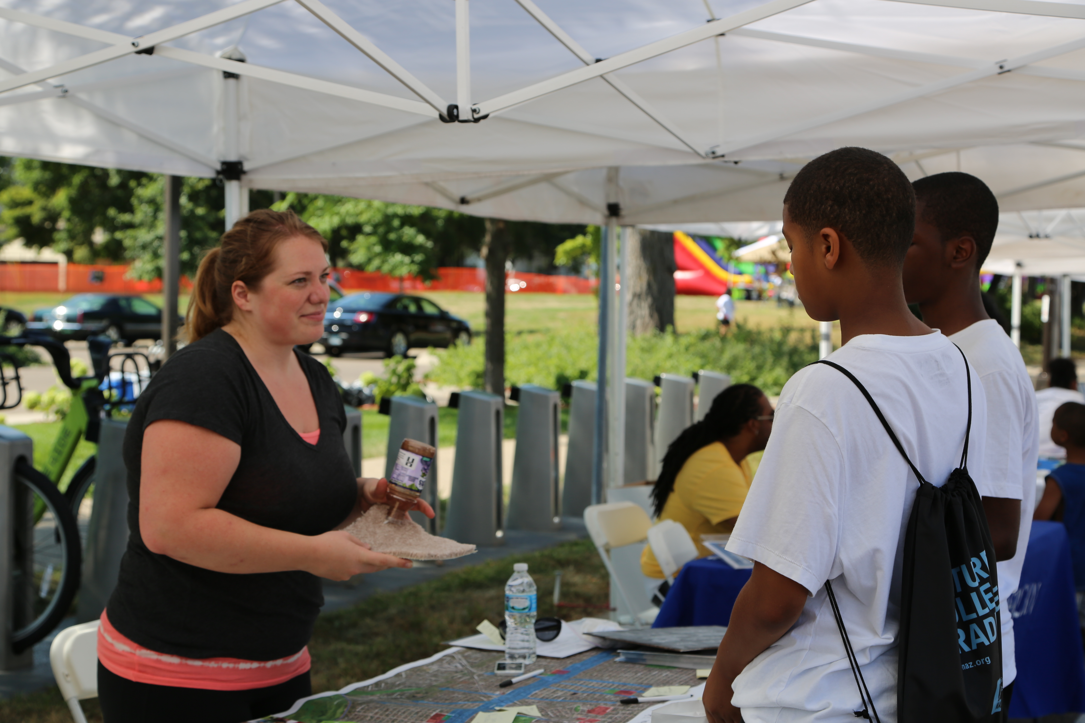
Step 3: Develop strategy
Have intentional conversations
Why: Give people information, problem solve
When: Lack of knowledge, increase motivation
Tips:
  Help people identify barriers
  and benefits
  Help people plan for how
  they will take action
  Speak to personal values
Notes:
The way you have conversations can help set people on the path to behavior change
You don’t have to have all the answers

Slide 10
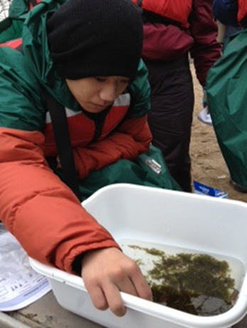
Step 3: Develop strategy
Let people try an activity!
Why: Build skills and knowledge.
When: Overcome anxiety that may prevent action.
Tips:
  Provide hands-on activities
  Make it easy!
  Make it fun!
Notes:
Trigger and major life events – people are out of normal routines and may be more open to trying something new
Moving
Become parents
Earth Day
Holidays

Slide 11
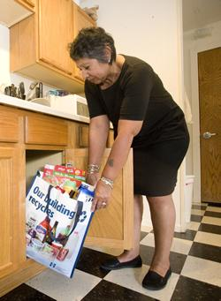
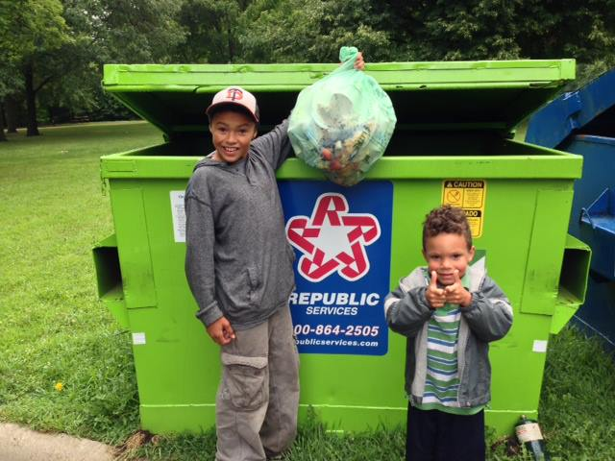
Step 3: Develop strategy
Make it easy to act
Why: People want convenience
When: External barriers are present
Tips:
  Decide if you can address the
  barrier
  Connect to resources
  Give people the tools need to
  take action
Notes:
Examples: recycling sorting; non-toxic cleaning

Slide 12


Step 3: Develop strategy
Build commitment
Why: Builds consistency in self-perception
When: To enhance motivation.
Tips:
  Public, written, group commitment.
  More likely to take larger actions after making smaller commitments.
Notes:
Written commitments more effective than verbal
Public even more effective (publishing in newsletter, posting to bulletin board, etc.)
Group commitments effective when have good group cohesion
Existing events or meetings; existing leaders
Example: Minneapolis Park and Rec Board, reducing pet waste
Held event where the dog dipped its paw in paint and “signed” a pledge card, then the owner signed as well.
Put on fridge as a reminder — associate it with a fun activity and love of their dog.

Slide 13
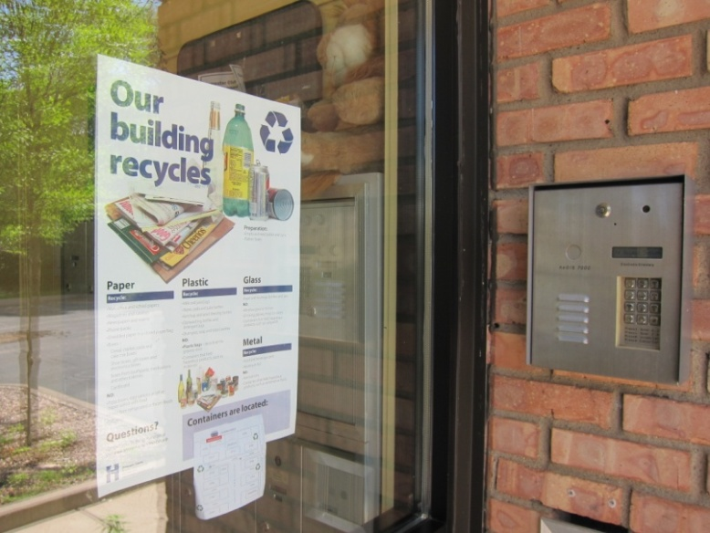
Step 3: Develop strategy
Create social norms
Why: We want to be socially accepted
When: Audience doesn’t believe it’s important to act.
Tips:
  “This is how we do things here.”
  Utilize community leaders
Notes:
Bad examples:
Worm giveaway for vermicomposting but no worm bins
Native plant seedlings or seeds to everyone who shows up
Good example:
Free rain barrels with installation assistance
Rain garden plants to everyone who submits a rain garden plan and commits to building it
Multifamily recycling – setting the expectation that the building recycles.
Can also get commitments – stickers on mailboxes to make public
Example: Grand Aspirations Our Power
Chalking energy use on sidewalks
Making hidden behavior visible, creating norm for the neighborhood

Slide 14
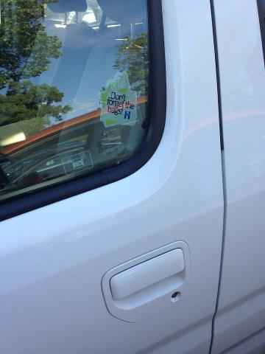
Step 3: Develop strategy
Use prompts
Why: Create habits.
When: Forgetting to act.
Tips:
  Noticeable/Visual
  Self-explanatory
  Close to action
  Encourage positive behaviors
Notes:
Water prompts:
Turn off water while brushing
Odd / Even sprinkling reminders
Forgetting to do something is a common problem
Using prompts can help make new repetitive behaviors a habit

Slide 15
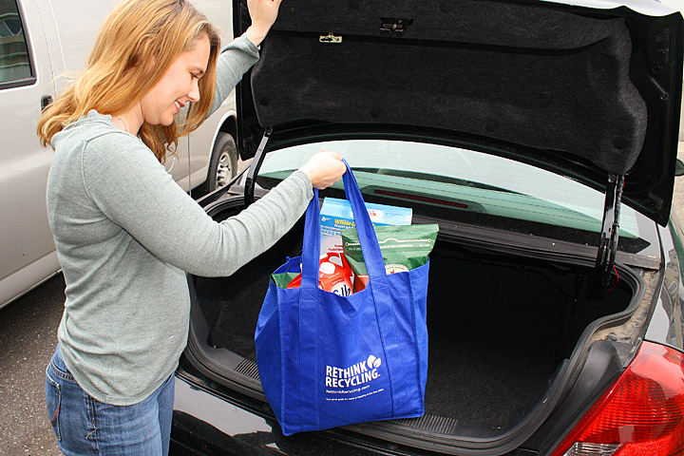
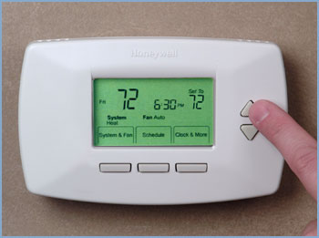
Step 3: Develop strategy
Offer incentives
Why: Motivate action
When: Significantly increase
motivation
Tips:
  Consider size and necessity
  Most effective with one-time
  behaviors
  Closely related to behavior
Notes:
When: incentives can be effective when people taking action is unlikely unless the motivation is significantly increased
Choose giveaways that help people overcome a barrier and take action
Examples:
MN Indian Women’s Resource Center: Free cloth diaper kit to all moms with babies
Reusable bags
Green cleaner spray bottles

Slide 16

Step 3: Develop strategy
Encourage social diffusion
Why: Continue building momentum.
When: Lack of knowledge
Tips:
  Identify and train leaders/early adopters
  Ask leaders to speak to others
Notes:
Train the trainer
MN Internship Center: students make two batches of non-toxic cleaners
Commit to giving their extra cleaner to someone and teach them about the cleaners
Required to provide feedback

Slide 17
Step 3: Develop strategy
Barrier | Strategy
Lack of motivation – value action | Commitment
Lack of motivation – don’t value | Norms
Significant lack of motivation | Incentives
Forget to act | Prompts
Lack of information | Social diffusion Communication
Lack skills; anxiety | Let people try an activity
External barriers | Convenient
  Worksheet Q3

Slide 18

Step 4 & 5: Pilot & Implement
Pilot with a small group
Evaluate
Make changes and implement broadly
  Worksheet Q4
Notes:
Implement with a smaller group – one or two classes, one or two businesses
Implement in-house first
Try out different strategies
Evaluation – outcomes vs. outputs
Behavior change – how many people took the desired actions to change their behaviors
Resource use – reducing waste, using less energy, etc.
Resource quality – improvements in water quality, air quality, etc.

Slide 19


Questions?
Patience Caso
Green Partners Program Manager
Hennepin County Environmental Services
612-348-9352
patience.caso@hennepin.us
www.hennepin.us/greenpartners
“Hennepin Environment” on Facebook
@hennepinenviro on Twitter

