Slide 1
What’s the problem
With runoff?

Slide 2
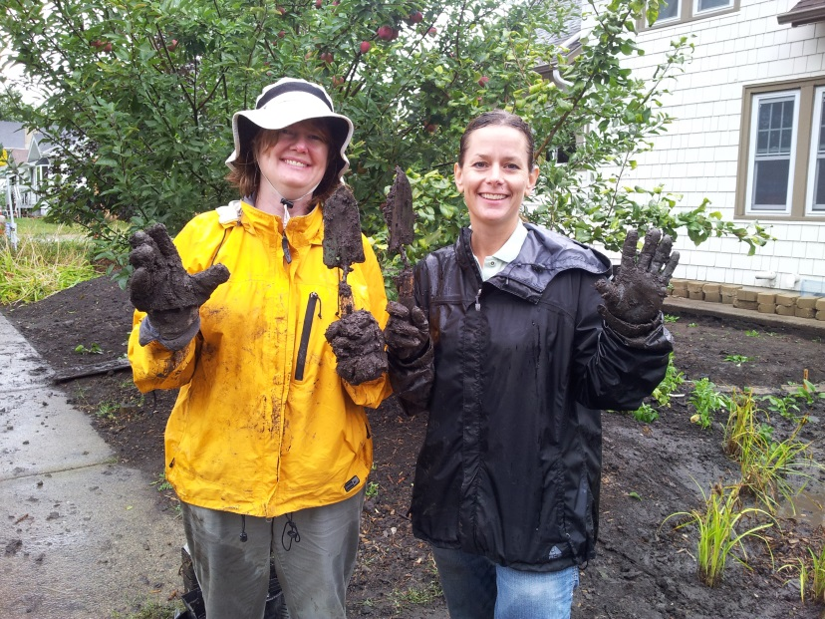
Master Water Stewards Program
Freshwater Society and
Minnehaha Creek Watershed District
Pilot Project
2013-2016
Polluted runoff is greatest threat to our waters
Train, certify and support community leaders
Identify pollutant sources
Education community members
Reduce pollutants
Coordinate Action
Modeled after Master Gardener/Naturalist Programs
2013 Academy focuses on the lower MCWD
Notes:
The Master Water Stewards program is a partnership between the Freshwater Society and the Minnehaha Creek Watershed District, funded by a Clean Water Fund grant. The program recruits, educates and certifies local community leaders who can work with their communities to reduce urban runoff.

Slide 3
Clean Water Act
Clean Water Act (CWA)- federal law regulating water quality and quantity
MN Pollution Control Agency- statewide agency charged with implementing the CWA
Issues a permit to entities requesting to discharge pollutants into public waters (cities)
Municipal Separate Storm Sewer Systems (MS4)
Notes:
So, now we back up to look at why we need this program in the first place. This will be a very quick overview. If you want to learn more, I invite you to go to the EPA web site and dig around.
Water is regulated by the federal Clean Water Act. The CWA was passed in 1972, because rivers were so polluted with industrial chemical waste they kept catching on fire.
Each state charges a state agency with implementing the CWA, and putting specific policies in place to ensure compliance with the Act. In MN, that agency is the Pollution Control Agency.
Any city in MN that want to discharge pollution to public waters- meaning any city that has a stormwater system- has to apply for a permit for that discharge… Permit holders are called MS4s, because they have a Municipal Separate Storm Sewer System.

Slide 4
Clean Water Act
Cities create local policies to regulate discharges
Construction
Stormwater
Water doesn’t follow political boundaries
Cities work with watershed districts to implement policies
Notes:
Cities with a permit- or MS4s- then create local policies to regulate certain kinds of pollution, to make sure the city can meet the permit they got from the state. The two most common types of regulations concern construction sites and stormwater
The hitch is, water doesn’t follow political boundaries, it follows geographic, topographical boundaries. So, MN has created watershed districts to help them coordinate work to reduce pollution.

Slide 5
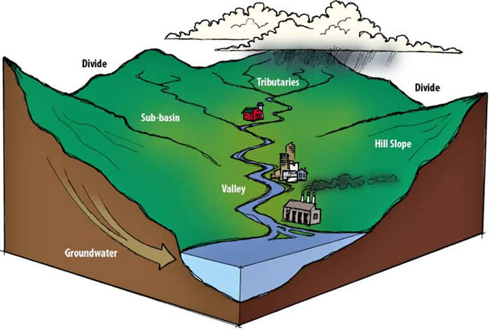
Notes:
A quick review- a watershed is the area of land that drains to a river or lake. Everyone on the planet lives in a watershed.

Slide 6
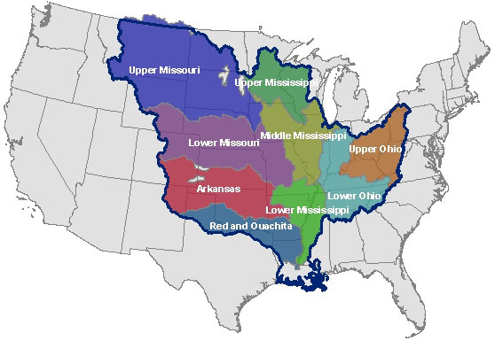
Notes:
The Mississippi Rivers Watershed drains 40% of America. Each big watershed basin is divided into sub-watersheds that nest inside of larger ones.

Slide 7
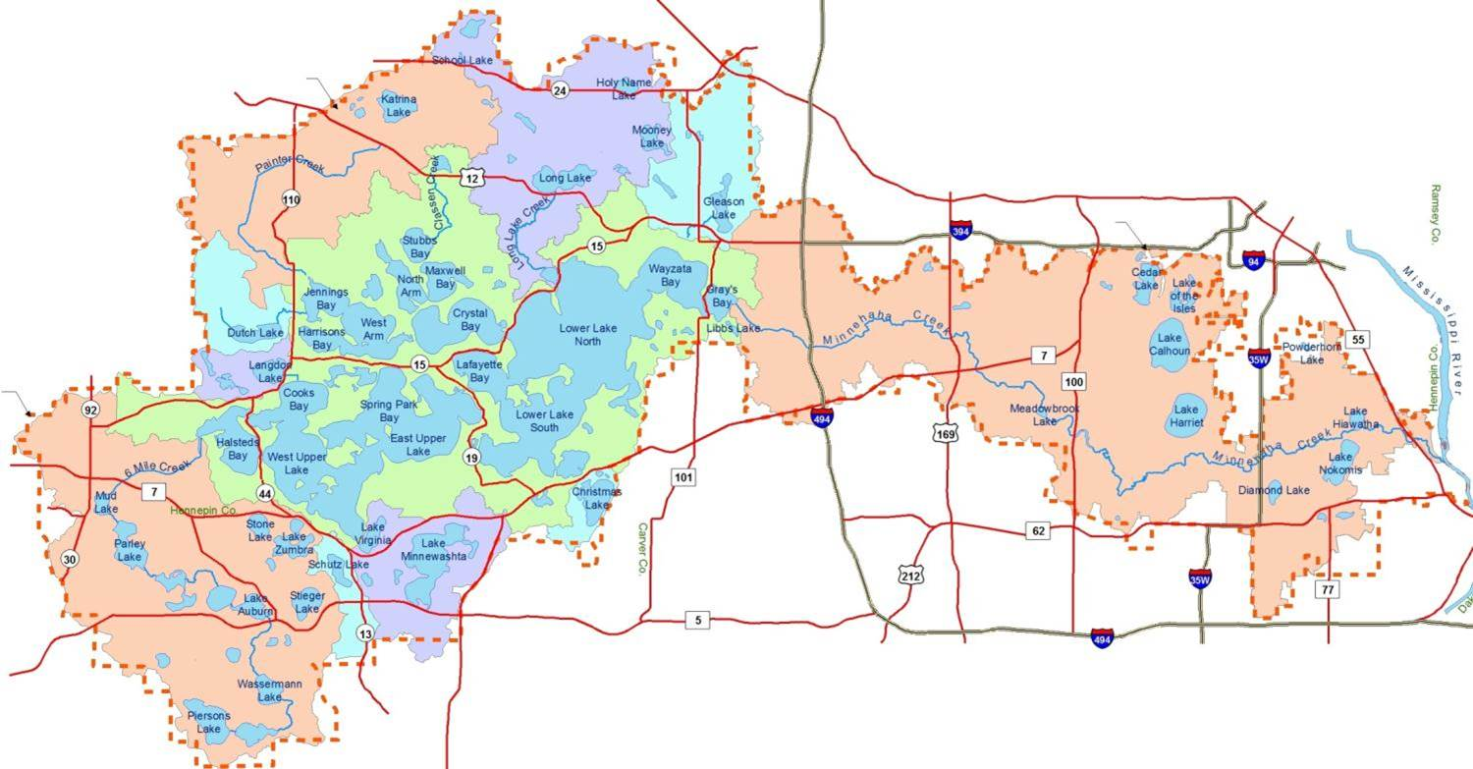
Notes:
The Master Water Stewards are currently working in the Minnehaha Creek subwatershed. The colored squares show the different cities in the watershed.

Slide 8
Clean Water Act
Minnesota Watershed District Act of 1955 charged watershed districts with integrating water management efforts among city, county, and state agencies.
Districts receive funding through local property taxes

Slide 9
Clean Water Act
New permit 2013- MS4s required to focus on actions residents can take to reduce pollutants
Change local business practices
Encourage installation of residential BMPs
Manage pet waste, yard waste, deicing chemicals
Work with lake associations to improve lakes
Other small scale storm water management measures
Notes:
The permit requires cities to do these things because when you pave the ground, water no longer soaks in, It all runs off into storm sewers and then into lakes and rivers. Cities HAVE TO find ways to get more water to infiltrate, or soak into, the ground.

Slide 10
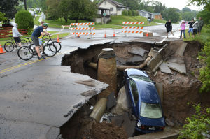
Duluth 2013
Notes:
With a changing climate, existing stormwater systems may no longer have the capacity to manage big, catastrophic rain events. Too much water in too little time, trying to fit into too small pipes, and this is the result.

Slide 11
Master Water Stewards Program
Freshwater Society and
Minnehaha Creek Watershed District
Pilot Project
2013-2016
Polluted runoff is greatest threat to our waters
Train, certify and support community leaders
Identify pollutant sources
Education community members
Reduce pollutants
Coordinate Action
Modeled after Master Gardener/Naturalist Programs
Notes:
The goal of the program is to get more water to soak into the ground. That will require changes in how we think and what we do.

Slide 12
Curriculum
Introduction to the Master Water Stewards program
Basic Hydrology
Stormwater 101
Water Policy and Governance
Environmental Decision-making and Behavior Change
Community Engagement
Watershed tour
Capstone
Rainscaping Basics
Rainscaping 2
Site Assessment and Stormwater Planning
Evaluating Existing Stormwater Management Projects
Aquatic Invasive Species
Notes:
This is a terrible slide, but the point is, we teach13 classes that frame a really robust, extensive exploration of water in urban settings. The program is 50 hours of classroom time, after which Stewards complete a rigorous capstone project.
This is the major difference between the Stewards program and the other “Master” programs. After the classroom hours are completed, the whole focus of the program shifts to doing something about urban runoff. There is a very strong orientation towards taking action.

Slide 13
Notes:
Let’s talk about the work Stewards do.
Every Steward has to complete a capstone project.
Each Capstone has four parts, and each of these four parts embodies the work Stewards can help our communities do to manage runoff:
Neighborhood observation- define the geographic boundaries of your neighborhood, then go out and look at it. Make observations of what is and is not happening on the land to manage water
Katherine and Dave worked in a several block radius around Katherines’ home, with neighbors who know her, and her dog.

Slide 14
Notes:
Education and Outreach campaign- Based on the Stewards’ observations, determine a behavior you want to influence, design and implement a campaign- this is where Stewards move neighbors toward Behavior Changes at Residential Scale
Jeff and Drew held an information session at Farmer’s Market
Registered people for a self-guided rain garden tour in the neighborhood
Raffled off rainbarrels

Slide 15
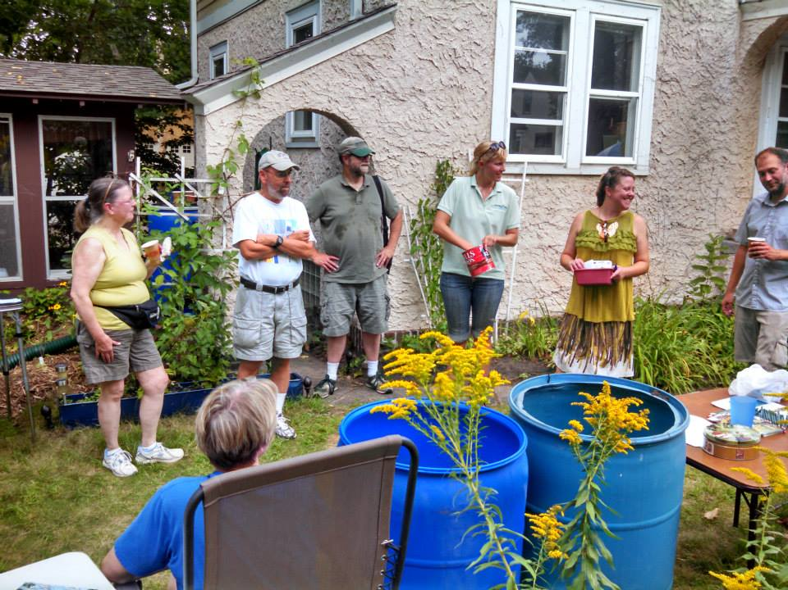
Notes:
Mary and Jessica threw a raingarden party and raffled off rain barrels.

Slide 16
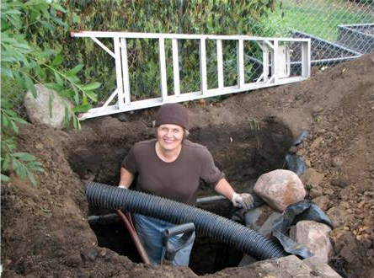
Notes:
The third piece of the capstone is a stormwater management project. Stewards design a stormwater management project (or work with a designer) and they install it, or have it installed.
Roxanne installed a 1700-gallon cistern

Slide 17
Notes:
Steve and Louann worked on a project in Edina, next to a redeveloped teardown. Neighbor property was raised 12 feet, sending stormwater flooding into client’s yard.

Slide 18
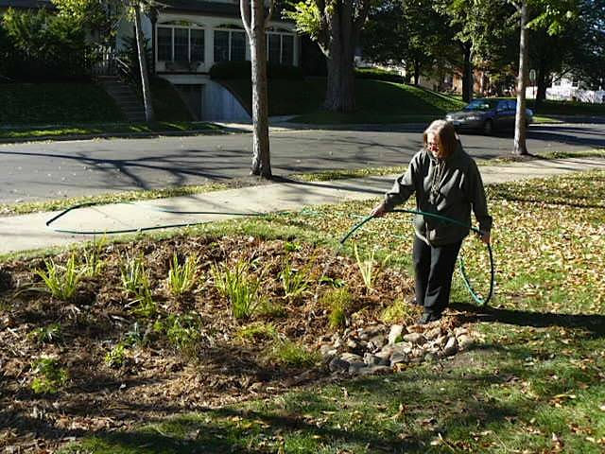
Notes:
Sheila and Terry put in a raingarden at Terry’s townhome association. Terry is president of his townhome association, 250 sq ft raingarden to address, the first of many gardens planned to reduce the $10,000 annual stormwater fee
This was a project in 2013. This year, Terry is working on the runoff from the parking lot. $200,000 project, but he feels he can raise the money and get it done.

Slide 19
Notes:
Project in Minnetonka, St. Luke Presbyterian Church. Volunteers planted close to 3000 plants in two raingardens.

Slide 20
Notes:
Anne lives down a steep hill, was a better candidate for raingarden, 120 sq ft raingarden, had to redo piping, added 4 catch basins
What all these folks have in common is that they have dirty hands. The knees of their jeans are filthy. They are Master Water Stewards.

Slide 21
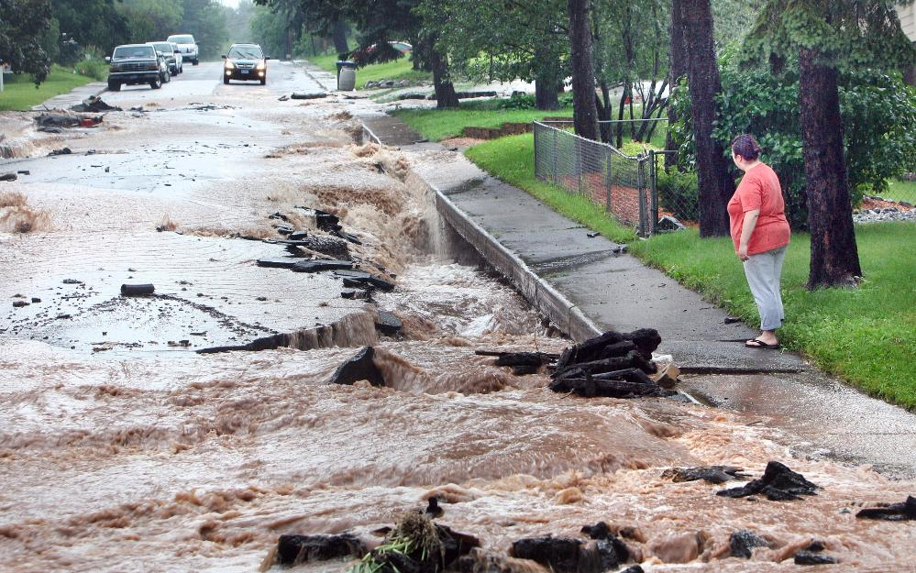
Master Water Stewards Program
React
Educate about Urban runoff
Interact
Influence behavior
Impact
Soak more water into the ground
Notes:
The goal is to REACT to the problem, INTERACT with your community and have an IMPACT by soaking more water into the ground

